Slide 1
Stroke Prediction Using Machine learning Technique
GROUP C

Slide 2
GROUP C
NEAW AIK KA : TP065116 (L)
TAI RUI XIAN : TP060922
SIAH YAO LIANG : TP061861

Slide 3

Problem Statements
Statements 1
Stroke, also known as a cerebrovascular accident (CVA), is a medical condition that occurs when the blood supply to a part of the brain is disrupted
Statements 2
This year alone ,12.2 million individuals are experiencing their first stroke, resulting in 6.5 million pass away.
Statements 3
The World Stroke Organization also states that metabolic factors, including cholesterol level smoking, all personal habits, etc. are responsible for 71.0% of the incident of stroke
Statements 4
Most stroke cases occur in low- and middle-income countries.

Slide 4





Aim / Objectives / Deliverables
Objective 1
Objective 2
Objective 3
To predict the likelihood of stroke risk cases happening by using simple data.
To develop an interface that can be used by anyone to make stroke prediction.
Identify the simplest indicators that lead to stroke.

Slide 5

Similar Systems
Journal Title | Brief summary | Models or techniques used | Findings/ Limitations
1. Random forest‑based prediction of stroke outcome | Researching clinical, biochemical, and neuroimaging with outcomes on stroke patients and generating a prediction. | Random Forest | Random forest algorithm effectively used in long-term outcome prediction of mortality and morbidity of stroke patient
2. Analyzing the Performance of Stroke Prediction using ML Classification Algorithms | Based on CDC, stroke is the fifth-leading cause of death in the US. Research is conducted for predicting the occurrence of a stroke. | Logistic regression, Decision tree, random forest, KK, SVM and VB | Out of all the algorithms chosen, Naïve Bayes Classification performs best with an accuracy of 82%.
3. Fully automated stroke tissue estimation using random forest classifiers (FASTER) | Several clinical trials have recently proven the efficacy of mechanical thrombectomy for treating ischemic stroke, within a six-hour window for therapy and introduced fully automated method to estimate penumbra. | FASTER | Random forest classifiers

Slide 6
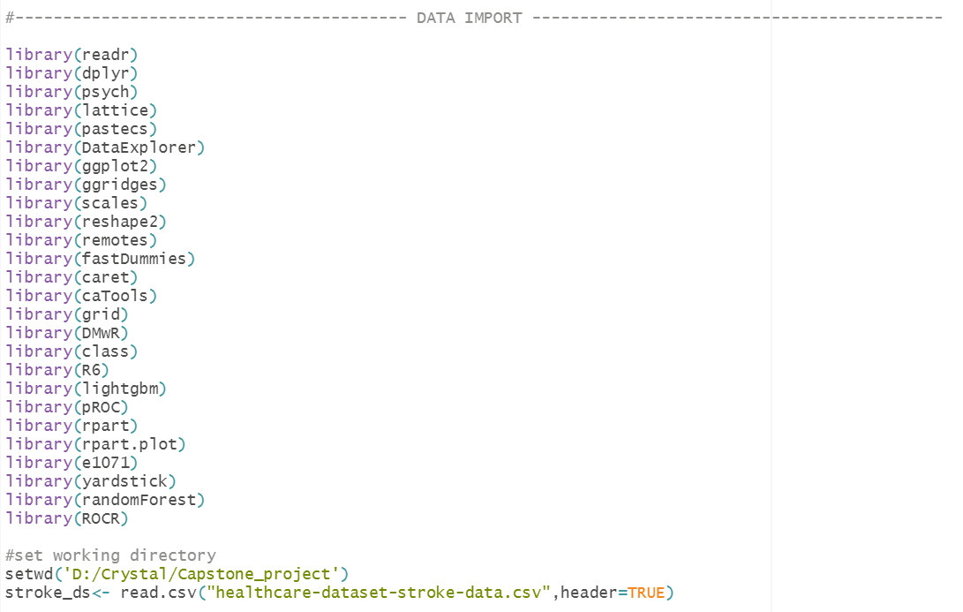
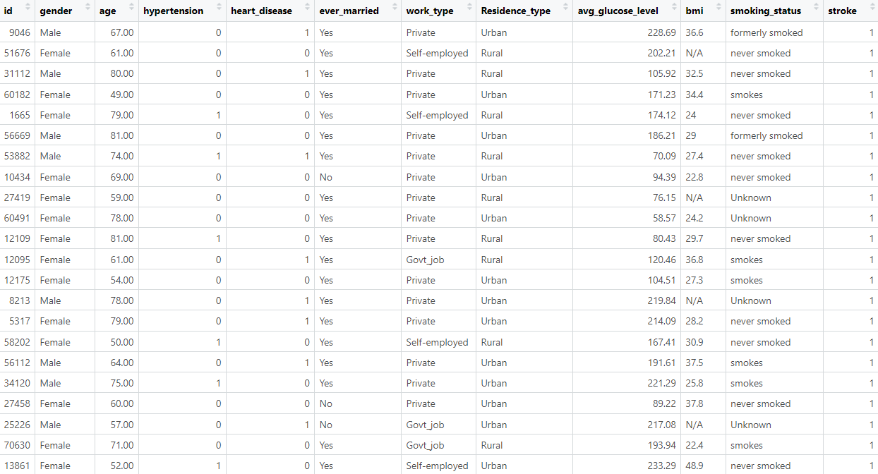
DATA IMPORT

Slide 7
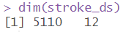
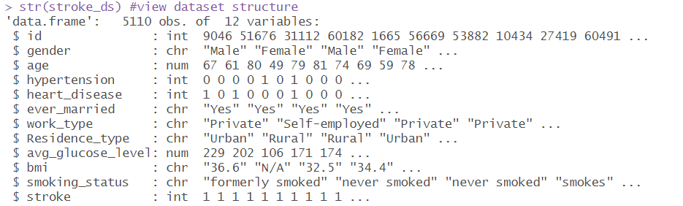
DATA EXPLORATION
Dimension of dataset
Structure of dataset

Slide 8
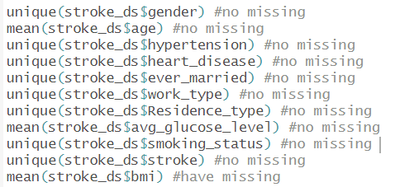
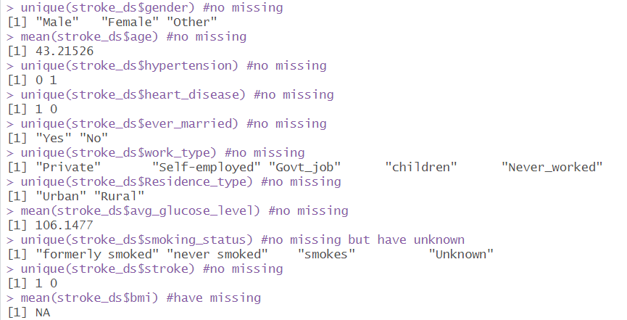
DATA CLEANING
Finding missing data in the dataset
Replace the missing value by BMI mean

Slide 9
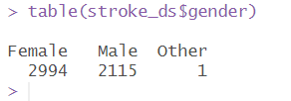
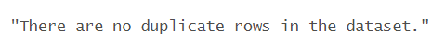
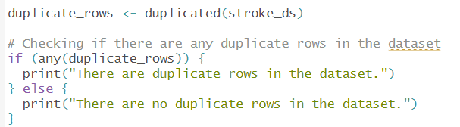
DATA CLEANING
Since there is only one gender that show other in the gender column
Remove it
Check is there is any duplicate data

Slide 10
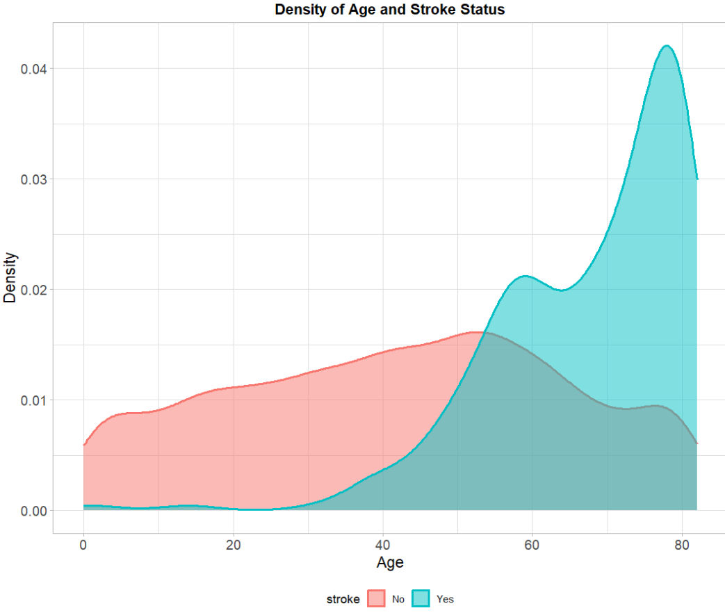
EXPLORATORY DATA ANALYSIS
Analysis 1
Risk of stroke begins to rise significantly starting at around age 40
Reach to the peak at age 78
When a patient gets older, their risk of having a stroke rises.

Slide 11
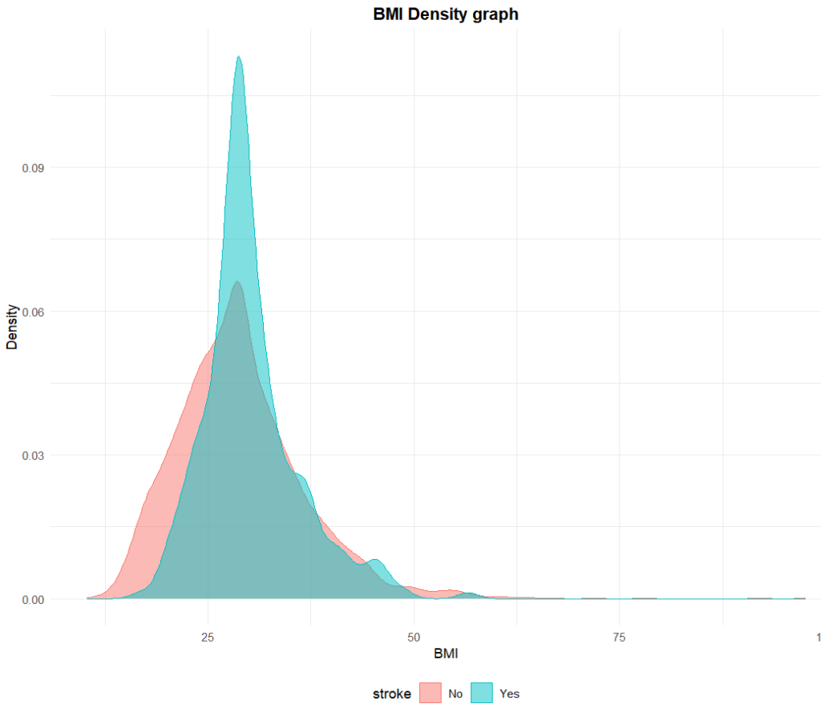
EXPLORATORY DATA ANALYSIS
Analysis 2
Majority of the patient BMI that getting stroke is 28.4.
Consider as overweight category .
Consist some outlier which will need to overcome.
Patient who is overweight has a higher risk of getting stroke compare to others BMI categories.

Slide 12
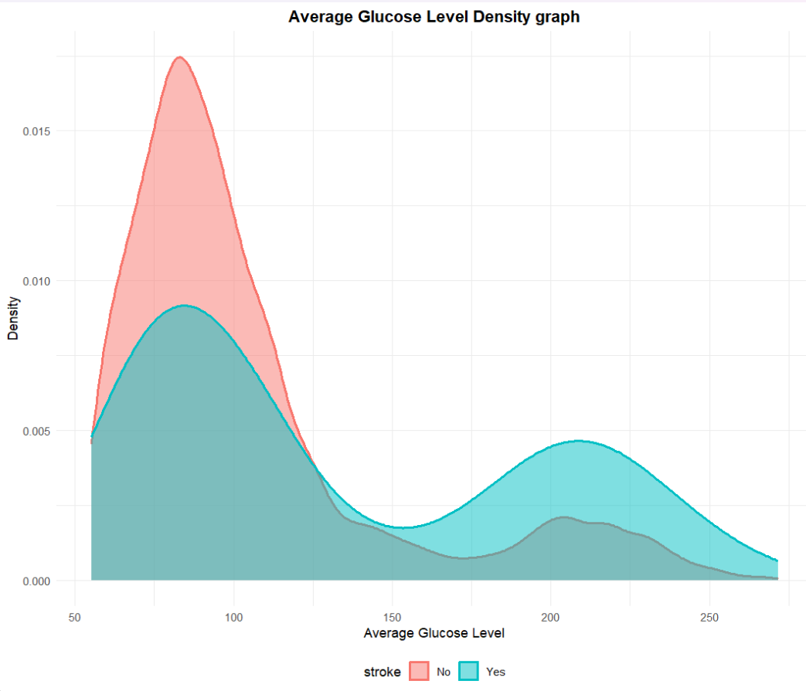
EXPLORATORY DATA ANALYSIS
Analysis 3
Patient healthy average glucose level is between 50 ~125.
Hypolycemia and normal level
The risk of getting stroke will increase, when the patient average glucose level is more than 125 which is an unhealthy level.

Slide 13

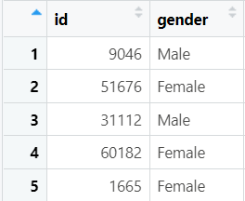
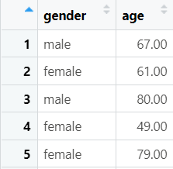
DATA TRANSFORMATION
Remove Index’s (id) column
Remove Index’s (id) column
11 columns

Slide 14
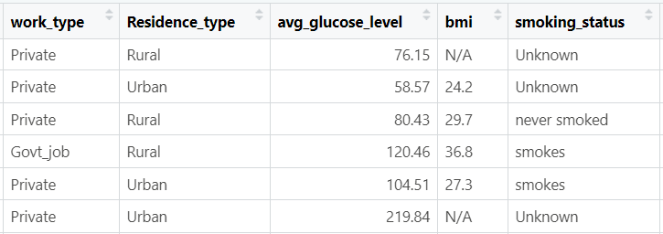
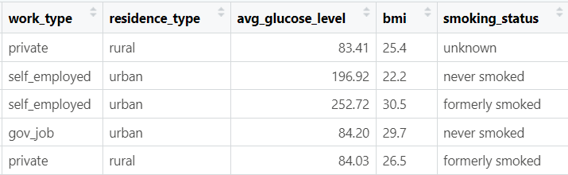

Standardize Variable and Columns Name
Rename
\
Label Encode
One-Hot Encode
Categorize + Encode

Slide 15

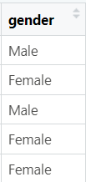
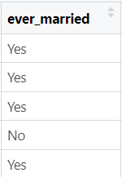
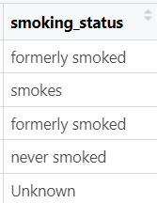
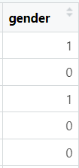
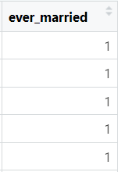
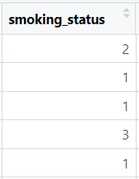
LABEL ENCODING
Encode into numerical such as
‘0’ and ‘1’ or from ‘0’ to ‘1’
Label Encode
Rename
\
One-Hot Encode
Categorize + Encode

Slide 16
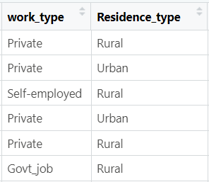

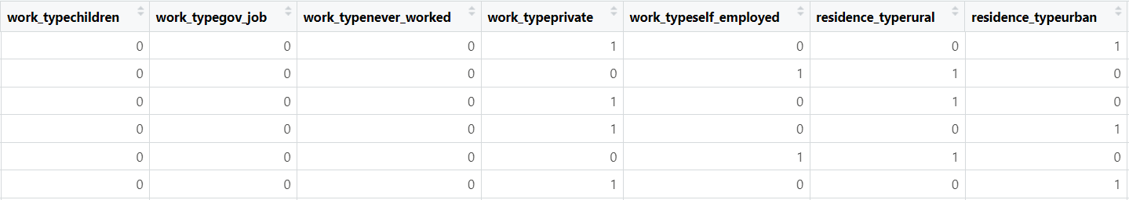
ONE-HOT ENCODING
Each categorical value encode in numerical ‘0’ and ‘1’
One-Hot Encode
Rename
Label Encode
\
Categorize + Encode

Slide 17

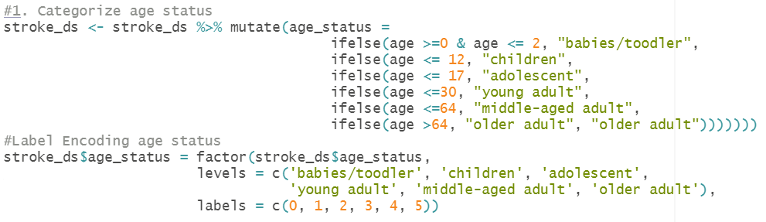
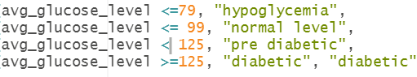
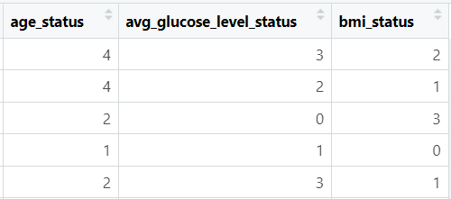
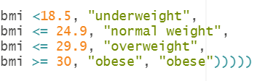
CATEGORIZE + ENCODING
Age
Average glucose level
BMI
Categorize + Encode
Rename
Label Encode
One-Hot Encode
\

Slide 18
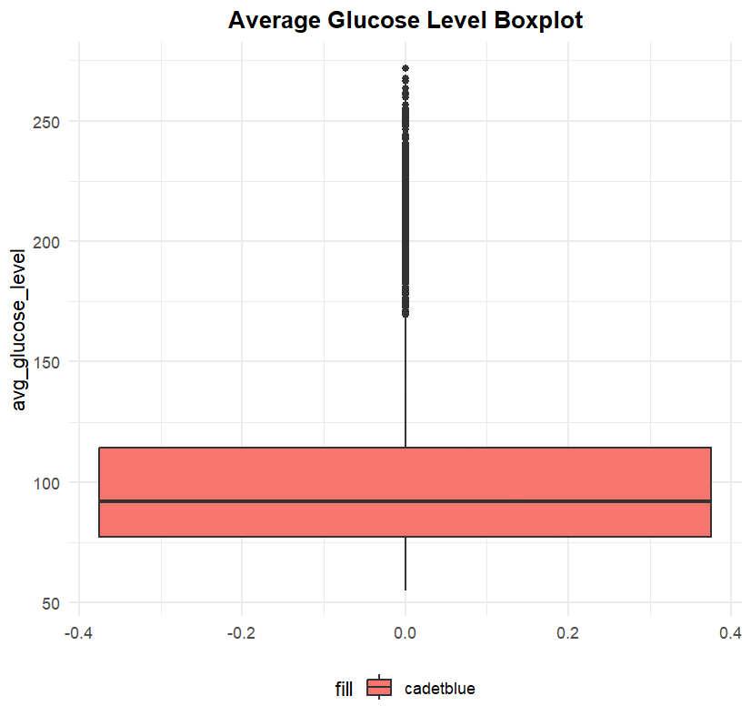
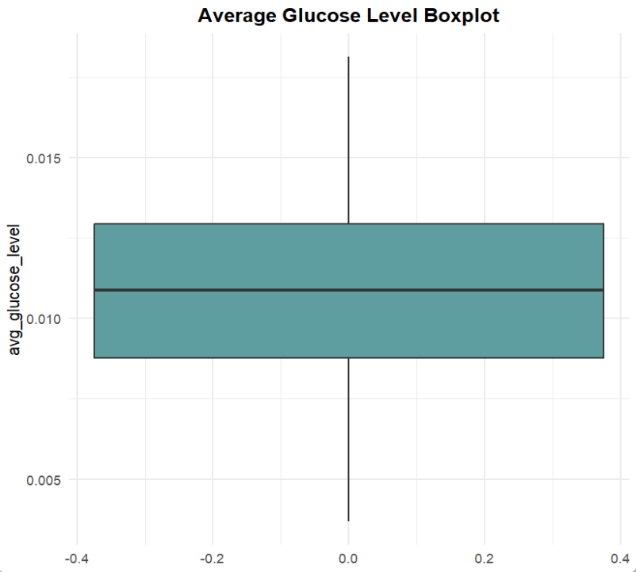
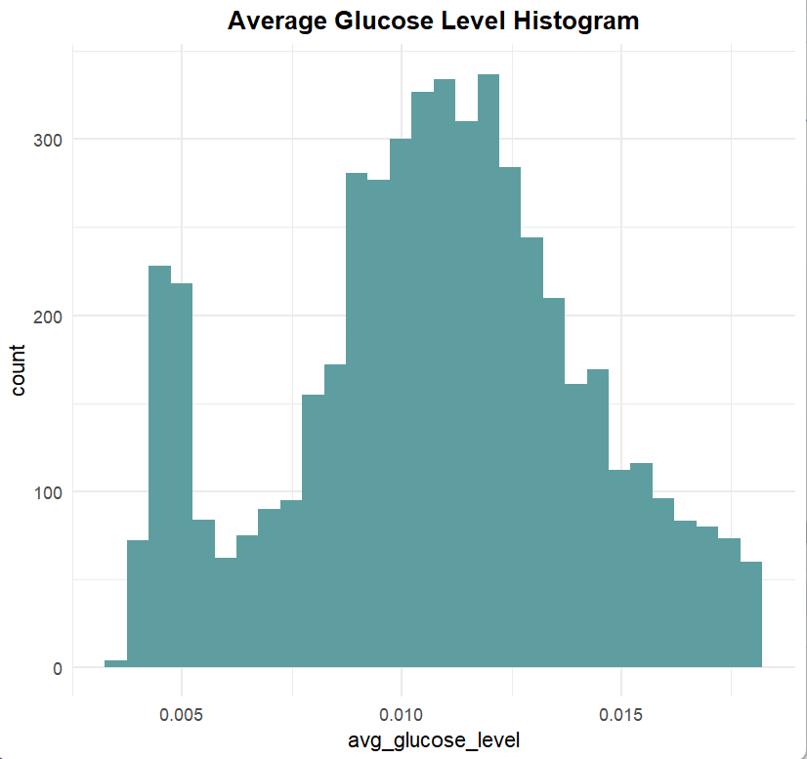
OUTLIER DETECTION & HANDLING
Before
After
Insight

Slide 19

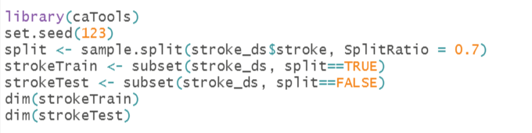
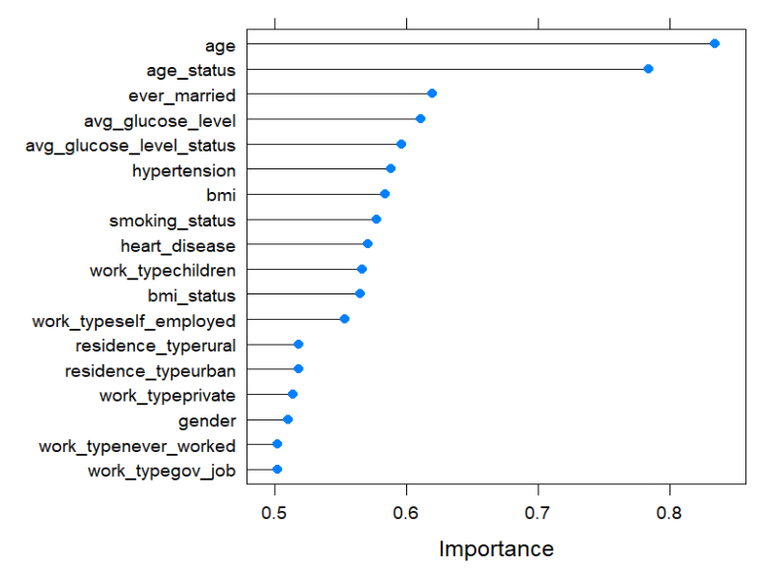
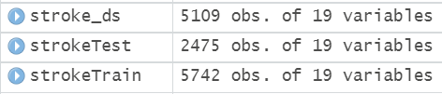
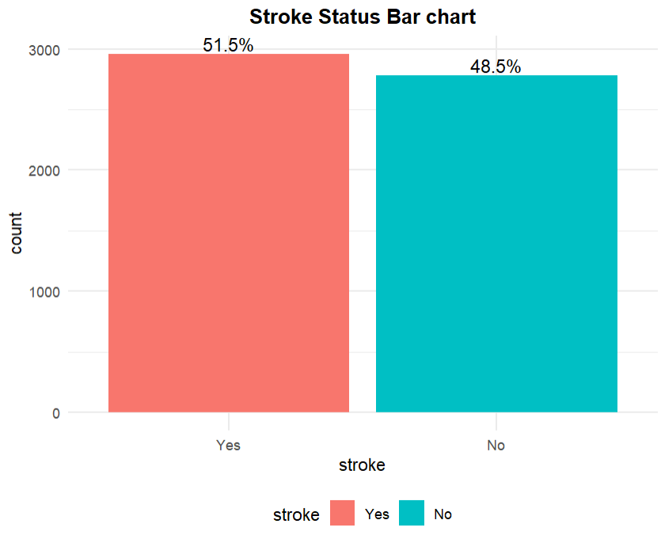

SMOTE & SPLITTING
RANK FEATURES BY IMPORTANCE
Age : Importance Rate 0.8345

Slide 20
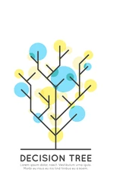
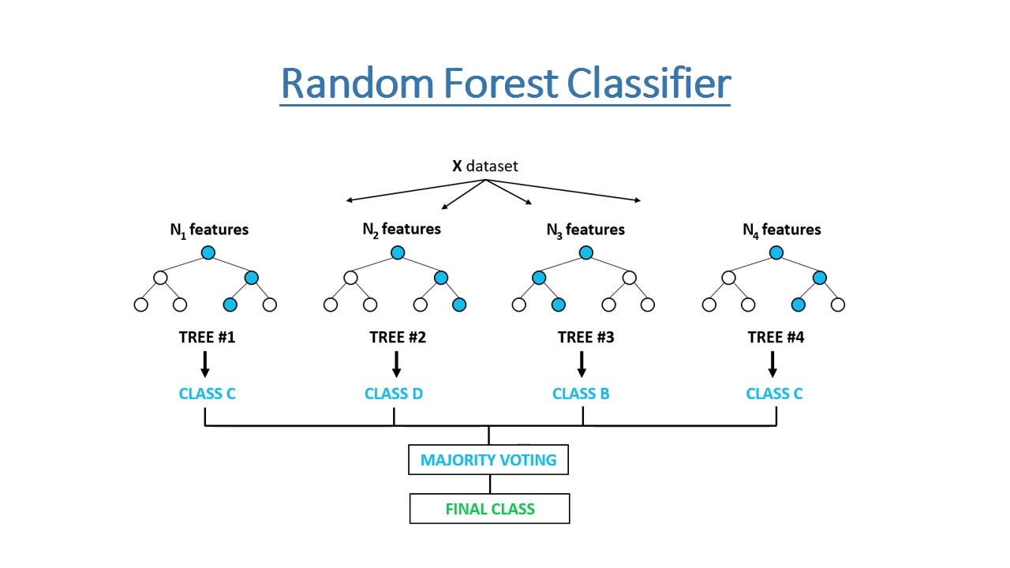
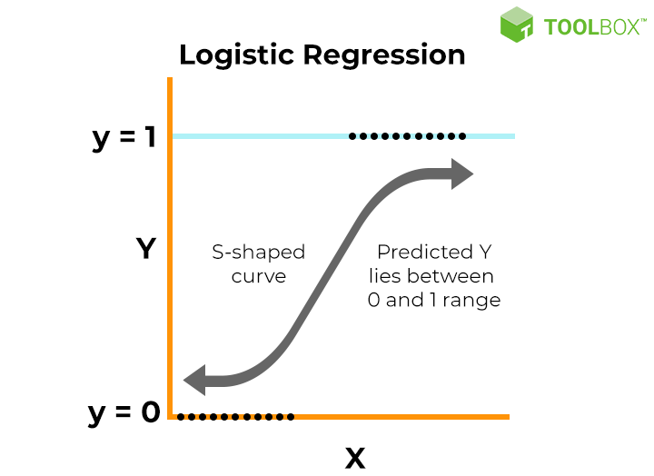
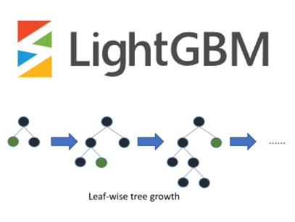
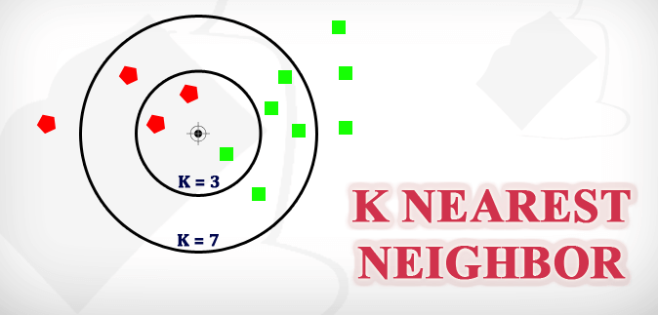
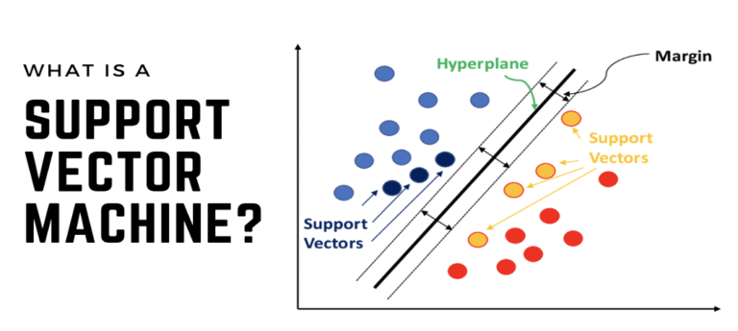

Slide 21
Model Accuracy Comparison
77%
84%
81%
73%
87%
70%
KNN
LightGBM
SVM
Decision Tree
Random Forest
Logistic Regression

Slide 22
Model Mean Squared Error (MSE) Comparison
0.23
0.16
0.19
0.27
1.38
1.5
KNN
LightGBM
SVM
Decision Tree
Random Forest
Logistic Regression

Slide 23
Model Mean Absolute Error (MAE) Comparison
0.23
0.16
0.19
0.27
1.12
1.14
KNN
LightGBM
SVM
Decision Tree
Random Forest
Logistic Regression

Slide 24
Model Root Mean Squared Error (RMSE) Comparison
0.48
0.40
0.43
0.52
1.17
1.22
KNN
LightGBM
SVM
Decision Tree
Random Forest
Logistic Regression

Slide 25
Model Precision Comparison
0.72
0.75
0.75
0.71
0.75
0.74
KNN
LightGBM
SVM
Decision Tree
Random Forest
Logistic Regression

Slide 26
Model Recall Comparison
0.85
0.94
0.91
0.75
0.98
0.70
KNN
LightGBM
SVM
Decision Tree
Random Forest
Logistic Regression

Slide 27
Model F1 Score Comparison
0.78
0.84
0.83
0.73
0.85
0.72
KNN
LightGBM
SVM
Decision Tree
Random Forest
Logistic Regression

Slide 28
Model Choosing
Random Forest
4
Ranked 1 in Accuracy, Precision, Recall, F1 Score
Logistic Regression
3
Ranked 1 in MAE, MSE, RMSE

Slide 29




Analysis Insights
Age
Basic, simple data
Marital Status
Just need to enter some of your body data
Heart Disease
BMI
Average Glucose Level
Affordable
No need go medical center, no need hundreds dollar
Accessible
Easily implemented and accessible

Slide 30
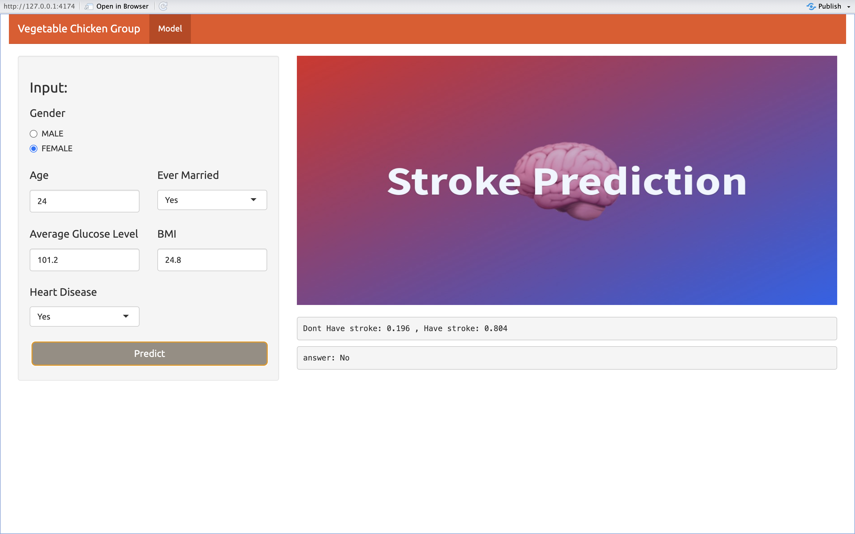

Slide 31
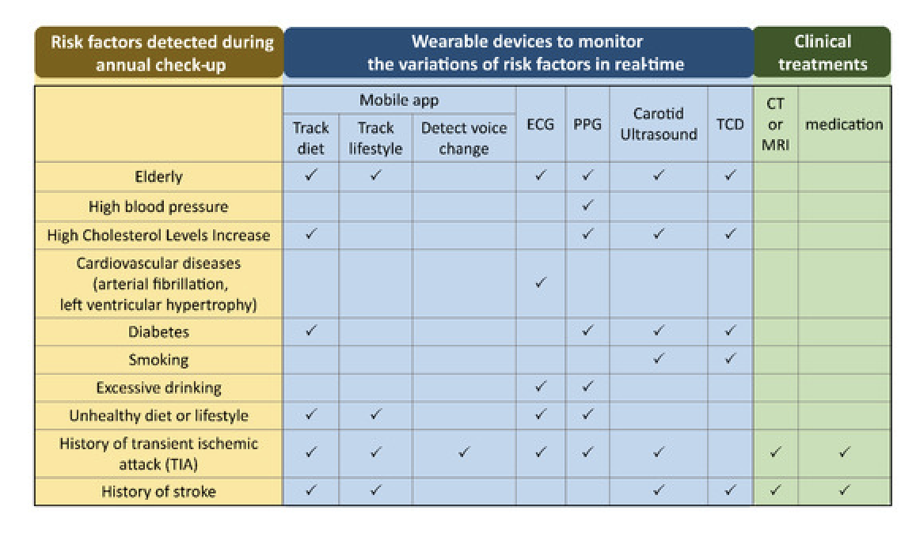
Market
The global cerebral palsy treatment market size was valued at $3166.82 million in 2020, and is projected to reach $4,365.01 million by 2030, registering a CAGR of 3.3% from 2021 to 2030.

Slide 32
Vision
Highly Accessible
Allowing people make stroke predictions using simple data and platforms
Fully Implementation
This prediction technology could be implemented to wearable devices, mobile phone, etc.
Helping people need
86% of stroke-related fatalities occur in low and middle-income community

Slide 33
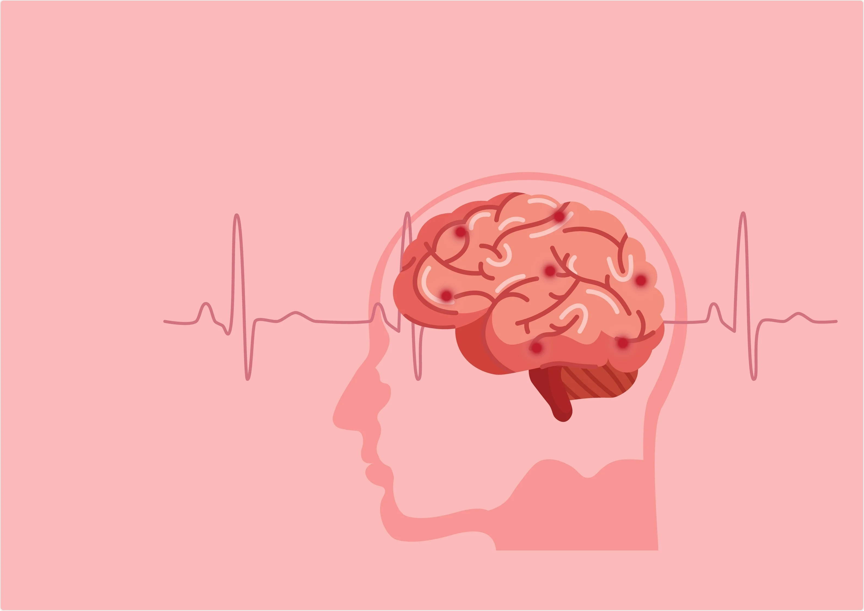
THANK YOU
THANK YOU

